Slide 1
Career Development Training Course
Enlisted Advancement
Notes:
FACILITATOR GUIDE:
As a CDT member, you may be asked to assist the ESO for advancement related questions within you dept/division. This lesson will help you in counseling Sailors regarding advancement opportunities.

Slide 2
Enabling Objectives
DISCUSS the enlisted advancement process and eligibility requirements.
DISCUSS the Final Multiple Score (FMS) and contributing factors.
IDENTIFY the process for calculating Performance Mark Average (PMA) and Reporting Senior’s Cumulative Average.
DETERMINE Time-in-Rate/Time-in-Service advancement requirements.
IDENTIFY the sources for Passed-Not-Advanced (PNA) points and how it is awarded.
IDENTIFY advancement incentive programs.
Notes:
FACILITATOR GUIDE:
Review objectives.

Slide 3
References
Advancement Manual for Enlisted Personnel of the U.S. Navy and U.S. Navy Reserve, BUPERSINST 1430.16 (Series)
Bibliography for Advancement Study, NAVEDTRA 10052
Catalog of Non-resident Navy Training Courses, NAVEDTRA 12061
Enlisted Navy Leadership Development, OPNAVINST 5351.2 (Series)
Manual of Navy Enlisted Manpower and Personnel Classification and Occupational Standards, NAVPERS 18068 (Series)
Navy Military Personnel Manual, NAVPERS 15560 (Series)
Navy Performance Evaluation System, BUPERSINST 1610.10 (Series)
Notes:
FACILITATOR GUIDE:
Review references.

Slide 4
Computing Eligibility Requirements Terms
Service in Paygrade (SIPG)
The amount of time a candidate has served in a paygrade.
Time-In-Rate (TIR) Date
Date from which an advancement candidate's total service in paygrade is considered to have commenced.
Time-In-Service (TIS)
Total time in the Navy and is calculated based off the Sailor’s Pay Entry Base Date (PEBD).
Terminal Eligibility Date (TED)
Date to which an advancement candidate’s SIPG is computed for advancement purposes.
Limiting Date
Date that advancement authorizations expires for respective advancement cycles.
Notes:
FACILITATOR GUIDE:
To understand the different components to determine advancement eligibility; counselors must understand the terms.

Slide 5
Advancement Eligibility
Be recommended by CO/OIC.
Have minimum Time-In-Rate (TIR). (TIS from E1-4)
Be in the proper path of advancement.
Meet special requirements (citizenship, security, medical, ASVAB) for certain ratings.
If required, complete service schools.
Evaluation completed within computation period for advancement cycle.
Maintain physical readiness per OPNAVINST 6110.1 (Series)
Must not have Fleet Reserve Request Pending, if before HYT date.
Notes:
FACILITATOR GUIDE:
These are the requirements a Sailors must meet to be eligible for advancement. Some of the requirements can be waived. This can be found in chapter 2 of BUPERSINST 1430.16.

Slide 6
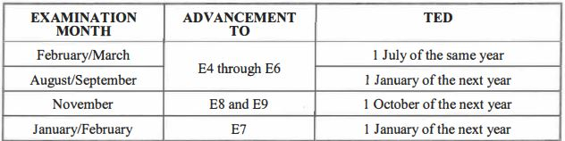
Terminal Eligibility Date (TED)
The advancement exam NAVADMIN will provide the TED based on the requirements below and must meet the TIR requirements for the next pay grade. (ie E5 to E6=36 months; E4 to E5=12 months)
Notes:
FACILITATOR GUIDE:
None

Slide 7
Time Requirements
Paygrade | Time
E1 to E2 | 9 months (Time in Service)*
E2 to E3 | 18 months (Time in Service)*
E3 to E4 | 30 months (Time in Service)*
E4 to E5 | 12 months (Time in Rate)
E5 to E6 | 36 months (Time in Rate)
E6 to E7
E7 to E8
E8 to E9
* Note: Time in Service is based on Pay Entry Base Date *
Notes:
FACILITATOR GUIDE:
Note that Time in Service is different than Time in Rate.
Time in rate is the minimum amount of time a Sailor must spend in their current paygrade to be eligible for advancement to the next rank. Page 27 of BUPERSINST 1430.16(s) has the TIR chart seen above.
For advancement to E4-E9, TIR is calculated to the TED of the advancement cycle.
E-6 candidates TIR requirements for early promote (EP) Sailors can be waived by one year with commanding officer (CO)/officer in charge (OIC) approval, IAW paragraph 214.e of BUPERSINST 1430.16F
EAW must be manually created for all E-6 EP TIR waiver authorized candidates.

Slide 8
Calculating TIR to TED
Prior PACT Sailor advances to new rate of ABH3.
TIR: 1 JUL 2024
TED for MAR 2025 cycle is 1 JUL 2025.
TIR required for E4-E5 is 12 months or 1 year.
2024 07 01 TIR
+ 1yr req TIR
2025 07 01
Can ABH3 take the March 2025 exam?
EN2 was meritoriously advanced on 1 Sept 2023.
TIR: 1 JUL 2023
TED for SEP 2025 cycle is 1 JAN 2026.
TIR required for E5-E6 is 36 months or 3 years.
2023 07 01 TIR
+ 3yr req TIR
2026 07 01
Can EN2 take the September 2025 exam?
Notes:
FACILITATOR GUIDE:
Review scenarios.
TIR requirement is based off the NAVADMIN’s TED date. So each Sailor must meet the TIR requirement by the terminal eligibility date.
Answer: YES to ABH3 and NO to EN2…. Explain why?
ABH3: although they advanced to E4 three months prior to the exam, they will meet the minimum 12 months TIR by 1 July 2025. Minimum TIR does not mean that they will have to be in that paygrade prior to taking an exam, it simply means that they need to be in that paygrade at least 12 months prior to advancing to the next paygrade. Based off the March 2025 examination, the first pay increment is not paid out until 16 July 2025 which allows them to meet the TIR requirement.
EN2: EN2 must meet 36 months from their TIR of 1 July 2023. This means that he would not meet that requirement until 1 July 2026. Since the September exam has a TED date of 1 Jan 2026, they must wait until the September 2025 exam in order to take the test unless they receive an EP TIR waiver.

Slide 9
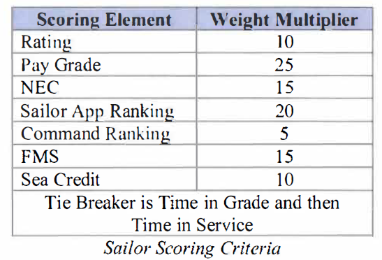
Sailor Scoring Criteria (SSC) for DMAP Sailors
Beginning with the March 2024 exam, the Navy-wide Advancement Exam (NWAE) for advancement to E-5 and E-6 transitioned to a Rating Knowledge Exam (RKE) for the DC and ABE ratings.
Sailors are only required to pass the RKE once per paygrade and all Time-in-Rate (TIR) requirements to take the exam are removed at the E-4 and E-5 paygrades.
Although not required to do so, Sailors who pass the RKE may voluntarily take future RKEs in an effort to improve their marketplace score as measured by the SSC in order to become more competitive in the marketplace through a higher exam score.
Sample SSC. Always verify on MyNavy HR:
Notes:
FACILITATOR GUIDE:
Always make sure you are using the most recent advancement NAVADMIN when counseling Sailors on SSC and DMAP.

Slide 10
Final Multiple Score (FMS)
The FMS method looks at the whole person and contributing factors vary by paygrade:
E-5/6:
Performance Evaluations
Experience (service in paygrade, awards, PNA points)
Exam score (standard score)
Education points
E-7:
Performance Evaluations
Exam score
Notes:
FACILITATOR GUIDE:
The FMS determines whether a Sailor advances or not. Always make sure you are using the most recent advancement NAVADMIN when counseling Sailors.

Slide 11
FMS breakdown E-5 candidates
Exam standard score – 80 points/ 47%
Performance Evaluation – 64 points/ 38%
Service in paygrade – 2 points/ 1%
Award points – 10 points/ 6 %
Education points – (2 AA or 4 BA/BS) – 4 points/ 2%
PNA Points – 9 points/ 6 %
Total Possible Points - 169/100%
Notes:
FACILITATOR GUIDE:
This slide shows the max possible points E5 candidates receive for each category.

Slide 12
FMS breakdown E-6 candidates
Exam standard score – 80 points/ 36%
Performance Evaluation/ RSCA PMA – 114 points/ 51%
Service in paygrade – 3 points/ 1%
Award points – 12 points/ 6 %
Education points – (2 AA or 4 BA/BS) – 4 points/ 2%
PNA Points – 9 points/ 4 %
Total Possible Points - 222/100%
Notes:
FACILITATOR GUIDE:
This slide shows the max possible points E6 candidates receive for each category.

Slide 13
FMS breakdown E-7 candidates
Exam standard score – 80 points/ 40%
Performance Evaluation/ RSCA PMA – 120 points/ 60%
Total Possible Points - 200/100%
Notes:
FACILITATOR GUIDE:
Max possible points E7 candidates can receive for each category.

Slide 14
Calculating Performance Mark Average (PMA)
Evaluations used for candidates:
E-5 – As per NAVADMIN (past 14 or 15 months)
E-6/7 – As per NAVADMIN (past 36 months)*
Always verify timeframes listed in the most recent NAVADMIN
Only the advancement recommendation (Block 45) of the evaluation is used to compute the PMA.
* E6 and E7 candidates will have their evaluation RSCA calculated towards their PMA.
Notes:
FACILITATOR GUIDE:
PMA is calculated using your evaluations. Ensure to review the current NAVADMIN to obtain which evaluations are to be used to compute PMA by paygrade.
RSCA PMA will be explained in future slides.

Slide 15
PMA Contribution to FMS
 |  | FMS Points
Block 45 | PMA | E-5 | E-6
EP | 4.0 | 64 | 114
MP | 3.8 | 48 | 98
P | 3.6 | 32 | 82
PROG | 3.4 | 16 | 66
Notes:
FACILITATOR GUIDE:
FMS chart can be found in BUPERSINST 1430.16 page 18.
Take note the differences in points that a Sailor can get between the performance blocks.

Slide 16
Reporting Senior Cumulative Average (RSCA) for E-6 and E-7 Candidates
Rewards additional PMA points towards their FMS.
Individual Trait Averages (ITA) and RSCA will be used to determine RSCA PMA.
Each evaluation RSCA value will be required to compute the RSCA PMA.
The RSCA PMA calculation is included in the automated Enlisted Advancement Worksheet (EAW).
Manual input can be done by ESO.
Notes:
FACILITATOR GUIDE:
Show NAVADMIN 312/18 or additional recent updates as applicable.

Slide 17
Reporting Senior’s Cumulative Average (RSCA) PMA
ITA Points Above RSCA | Additional RSCA Points
0.05 to 0.19 | 0.20
0.20 to 0.34 | 0.40
0.35 to 0.49 | 0.60
0.50 to 0.64 | 0.80
0.65 to 0.79 | 1.00
0.80 to 0.94 | 1.20
0.95 to 1.09 | 1.40
1.10 to 1.24 | 1.60
1.25 or greater | 1.80
*Example to calculate provided in Facilitator Guide
Notes:
FACILITATOR GUIDE:
Show counselors how to calculate RSCA. Example problems are in NAVADMIN 312/18.
Example from NAVADMIN:
Each of the RSCA evaluation values will be added together and divided by the number of evaluations to get the RSCA PMA (rounded to two decimal places).
EXAMPLE: EVAL 1: EP; ITA = 4.71; RSCA = 3.77; POINTS ABOVE RSCA = 0.94
EVAL 2: MP; ITA = 4.29; RSCA = 3.86; POINTS ABOVE RSCA = 0.43
EVAL 3: P; ITA = 3.14; RSCA = 3.58; POINTS ABOVE RSCA = 0.00
RSCA EVAL1 = 4.00 + 1.20 = 5.20
RSCA EVAL2 = 3.80 + 0.60 = 4.40
RSCA EVAL3 = 3.60 + 0.00 = 3.60
RSCA PMA = (5.20 + 4.40 + 3.60)/3 = 4.40
Note: The RSCA value for each evaluation will be a requirement for computing RSCA PMA. If the RSCA value is missing for any of the evaluations in the PMA of the advancement cycle computation period, then RSCA PMA will be equal to 0.00 and will be considered a discrepancy until resolved by the command.

Slide 18
Passed Not Advanced (PNA) Points
PNA points come from two sources:
PMA
Exam Standard Score (SS)
Awarded to those who pass the exam, but are not advanced due to quota limits
Points awarded each exam cycle based on relative ranking to peers:
Top 25% PMA =1.5 points
Top 25% SS = 1.5 points
Up to 3.0 total PNA points earned per exam cycle, for up to 3 cycles
Notes:
FACILITATOR GUIDE:
PNA points are only creditable for E5 through E6 candidates who achieve high NWAE standard scores or have high PMAs during the advancement cycle in which the candidate competed for advancement but were not advanced due to quota limitations.
Note that for those who have been in the Navy for some time were used to PNA points going back to the last 5 exams and that has since been updated.

Slide 19
Enlisted Advancement Exam Schedule
Jan | 3rd | Thursday | E-7
Mar | 1st | Thursday | E-6
 | 2nd | Thursday | E-5
Sep | 1st | Thursday | E-6
 | 2nd | Thursday | E-5
SELRES | 1st -28th (29th) | February | E5-E7 Exam
SELRES | 1st -31st | August | E-5/E-6
Notes:
FACILITATOR GUIDE:
Eligible Sailors are still required to complete PMK-EE and be promotion recommended. Examinations for E-5, E-6, and E-7 candidates will always be on Thursdays (unless changed by published NAVADMINs).
SELRES E-3 to E-4 fall under the PRISE-R advancement process. Advancement exams are not required.
The Enlisted Advancement Worksheet (EAW) is the authoritative source of all data used to determine advancements.
Professional Military Knowledge - Eligibility Exam (PMK-EE) completion deadline normally is 31 December prior to taking advancement exams. For more details please see most recent NAVADMIN.

Slide 20
Advancement Exam Participation Requirements
Enlisted Leadership Development Course are required prior to taking the exam for E6 and E7 candidates starting January 2025.
Professional Military Knowledge Eligibility Exam (PMK-EE) and Enlisted Leadership Development course is mandatory for participation in advancement cycle.
Complete once per paygrade (Except E4)
E-5 through E-7 candidates
Sailors must review the following: Evals, Awards, PMK-EE completion, ELD and RSCA computation on Enlisted Advancement Worksheet (EAW).
EAW is located in NSIPS
Sailors must sign verifying it is accurate and then route to Educational Services Officer (ESO)
Education points will not be on the EAW but if Sailor has a degree, ensure it is in the service record
Notes:
FACILITATOR GUIDE:
Slides 20-29 provides the steps to completing the EAW worksheet.

Slide 21
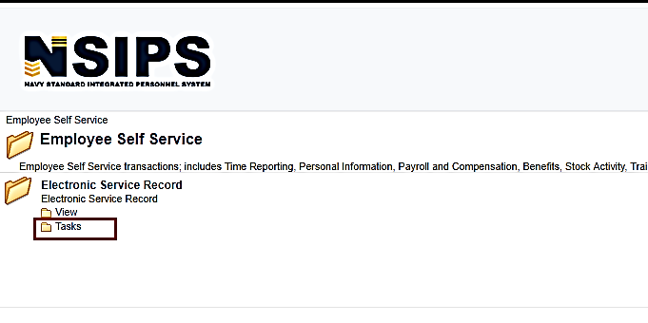
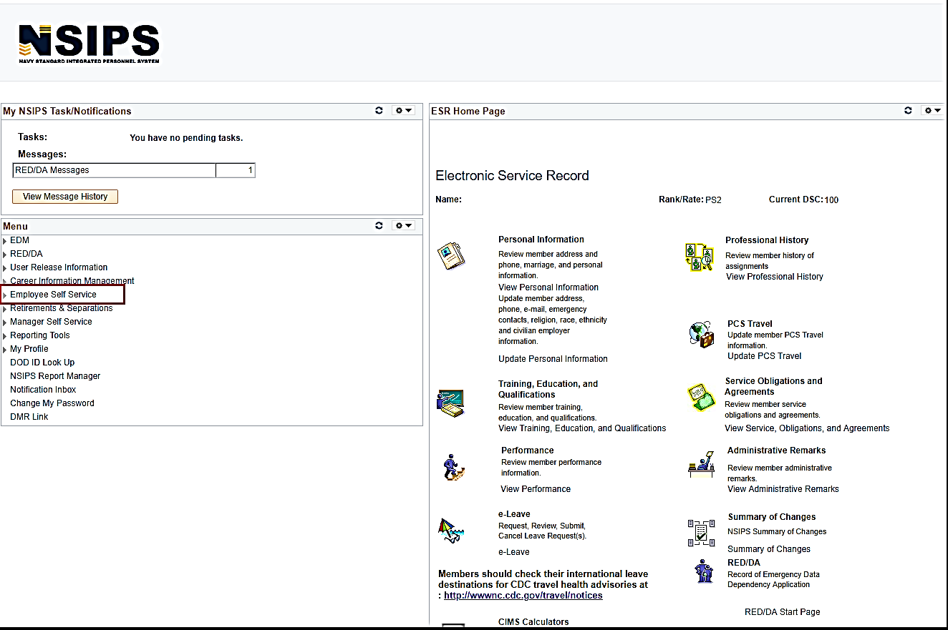
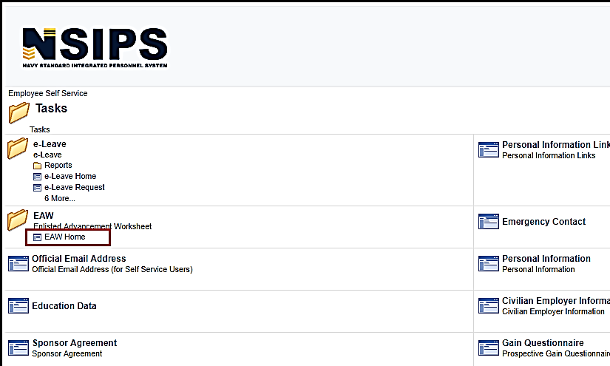
Enlisted Advancement Worksheet
Step 1: Log in to NSIPS.
Step 2: Click on “Employee Self Service”
Step 3: Click on “Tasks”
STEP 4: Click on “EAW Home”
Notes:
FACILITATOR GUIDE:
The Enlisted Advancement Worksheet is located on NSIPs.
Once logged in:
Click on Employee Self Service → Tasks → under EAW, click on EAW home.

Slide 22
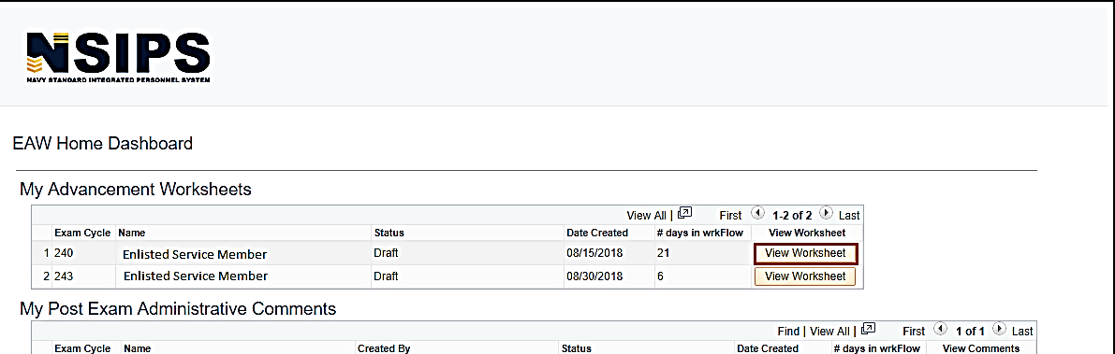
Enlisted Advancement Worksheet cont…
Step 5: Click on the UPCOMING worksheet.
Note: If you have completed multiple cycles of worksheets via NSIPS, there may be several available.
Notes:
FACILITATOR GUIDE:
None.

Slide 23
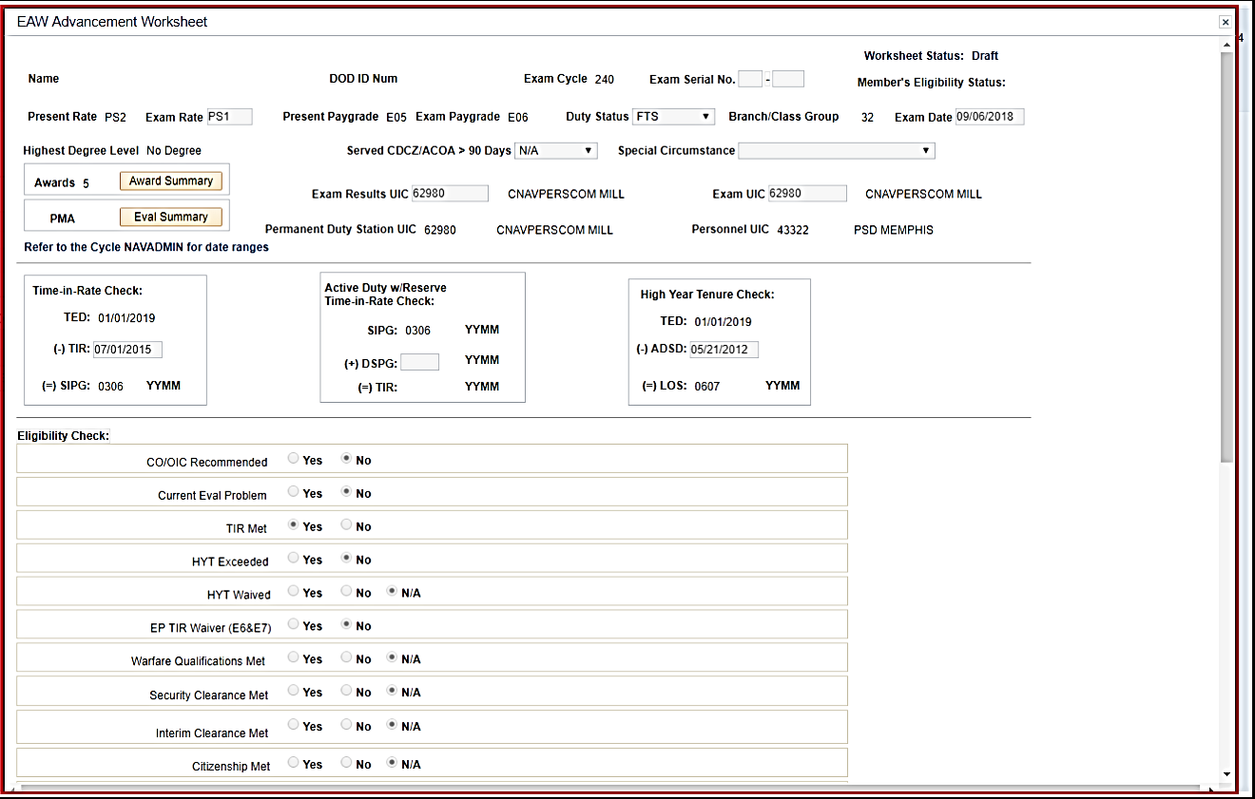
Enlisted Advancement Worksheet cont…
A new window will pop up – this is your Electronic Advancement Worksheet (EAW).
Step 6: Verify your information
DOD ID Number
Exam Cycle
Present Rate/Exam Rate
Present Paygrade/Exam Paygrade
Highest Degree Level
Duty Status
Are you taking the exam for a special circumstance (i.e. EP Waiver or LDO purposes)
Exam Results – will you still be at this UIC when results are expected to be released?
Exam UIC – Are you transferring before taking the exam?
Time in Rate
Notes:
FACILITATOR GUIDE:
Once the Sailor has clicked “View Worksheet” – a pop up window will appear (they may need to enable their pop-ups!)
This is their actual worksheet.
Sailors should verify ALL of the data/information to ensure everything is accurate.
Why is it important to verify Time in Rate?
1. To verify the Sailor is actually eligible for the exam and
2. because it involves points on the overall score. If TIR is only showing 0300 vice 0500 – this is a big difference.

Slide 24
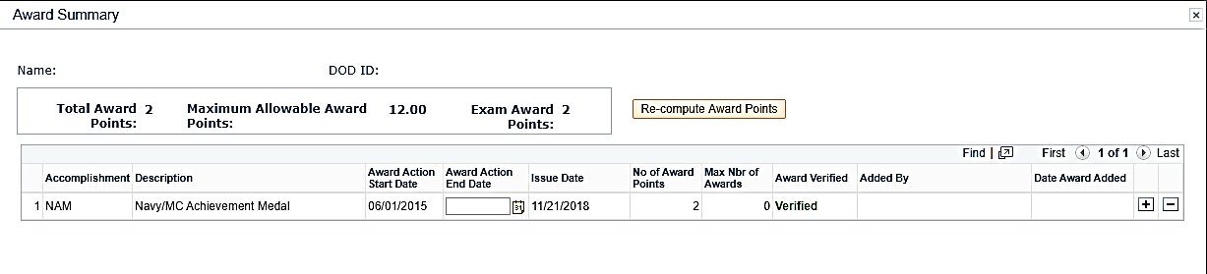
Enlisted Advancement Worksheet cont…
Step 7: Click on Award Summary to verify your awards are correct.
If the awards do not show “Verified”, you will have to upload a copy of the award for the ESO to verify.
Notes:
FACILITATOR GUIDE:
Awards:
This is where we see the most issues once results have been released and a Sailor missed the exam by less than 2 points.
Check NDAWS, the PSR, NSIPS Awards History, etc. to verify all awards (if applicable) are listed here.
Notice it says Maximum Allowable Award Points – The Sailor could have 14 points, but the maximum allowable is only 12 points. That is all they will receive, not the entire 14 points.
As per BUPERSINST1430.16G paragraph 307 – Enter points only for awards APPROVED or EARNED prior to the day of the regularly scheduled NWAE. Awards with only a month/year date are presumed to have an ending date on the last day of the respective month.

Slide 25
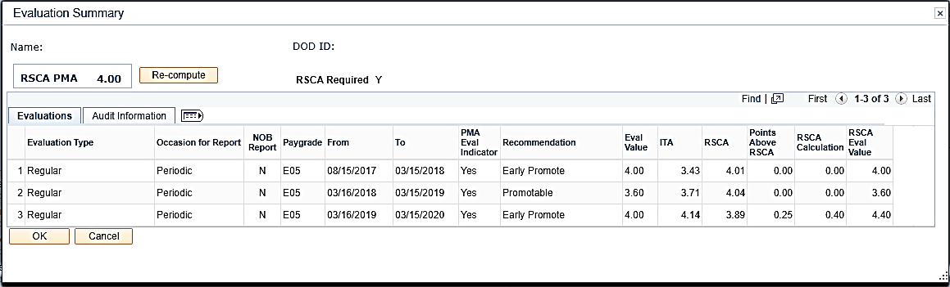
Enlisted Advancement Worksheet cont…
Step 8:
Verify Eval Summary
NAVADMIN will specify which evaluations to use for the advancement cycle.
Each day should be accounted for to ensure continuity is maintained.
Notes:
FACILITATOR GUIDE:
Current rank – only the evals in your current rank can be utilized on the EAW. Example if the Sailor is taking the E5 exam, only the E4 evals can be utilized.

Slide 26
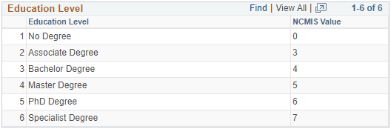
Enlisted Advancement Worksheet cont…
Education points are ONLY authorized if your degree is annotated on your Joint Service Transcript.
**This is NOT something your ESO can add unless it is in your JST. A copy of your diploma will NOT suffice**
How to update your JST:
Active Duty and Veterans: Have an official transcript sent from the institution directly to the JST Operations Center. Transcripts supplied by service member will NOT be accepted; they must come DIRECTLY from the institution.
NETPDTC
ATTN: JST Technology Operations Center, Code N644
6490 Saufley Field Road
Pensacola, FL 32509
DSN: 753-6013
Email: jst@doded.mil
Notes:
FACILITATOR GUIDE:
Per BUPERSINST 1430.16G “Education points will be calculated and credited by the Joint Services Transcript (JST). Naval Education and Training Professional Development Center (NETPDC) will receive data from Navy College Management Information System for calculations into the Candidate’s FMS.

Slide 27
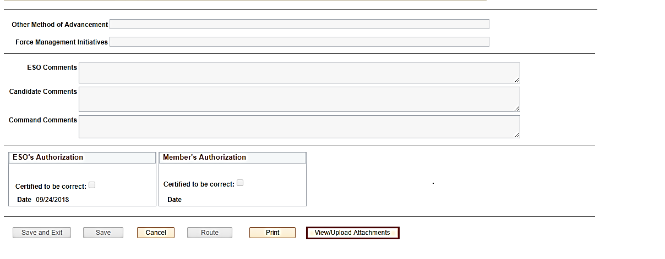
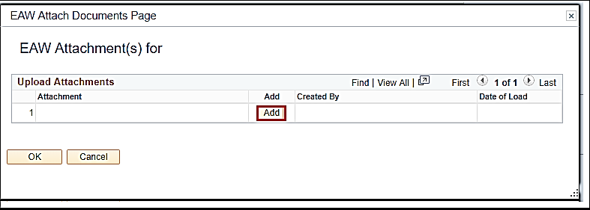
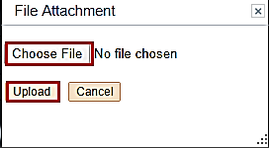
Enlisted Advancement Worksheet cont…
Step 9:
Add and upload each document that was previously identified as missing or not verified.
Notes:
FACILITATOR GUIDE:
If something is CHANGING on the EAW, there has to be proof/documentation to what is changing and WHY.

Slide 28
Enlisted Advancement Worksheet cont…
Eligibility Check:
This shows the Sailor and the ESO if there are currently any issues with a Sailor’s record that could interfere with their eligibility.
In the upper right-hand corner, it states “Member’s Eligibility Status”: Potentially Eligible or Potentially Ineligible
Notes:
FACILITATOR GUIDE:
PMK-EE:
Required ONCE per paygrade. This is a MANDATORY requirement and it SHALL be completed prior to the date annotated in the NAVADMIN.
You can NOT front load the PMK-EE Training i.e. An E4 cannot go knock out their E5, E6, and E7 PMK-EE. It has to be done during that particular paygrade before the exam.
If a Sailor does NOT complete their PMK-EE prior to the due date – they will be ineligible for the exam.

Slide 29
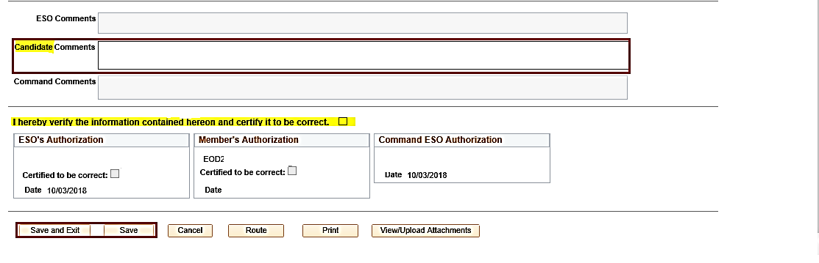
Enlisted Advancement Worksheet cont…
Step 10: Input comments to the Command ESO.
Example: “Added missing awards, should have 8 points total. Added missing transfer eval for period 18JUN23-19MAR15.”
Step 11: SAVE your work!
Notes:
FACILITATOR GUIDE:
None.

Slide 30
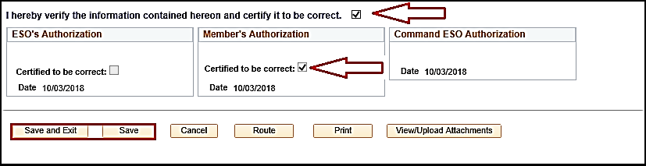
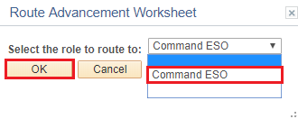
Enlisted Advancement Worksheet cont…
Step 12: Once all documentation has been uploaded, all evals are correct, and nothing else is missing – check both boxes:
“I hearby verify the information contained hereon and certify it to be correct.”
“Certified to be correct.”
Step 13: Route to ESO. This may say Command ESO, Assistant ESO, or just ESO.
Notes:
FACILITATOR GUIDE:
None.

Slide 31
Accelerated Advancement
MILPERSMAN 1510-030
AEF/Nuclear Field
ATF:
Advanced to E-2 or E-3 upon reclassification into field
Other Class “A” schools
Top 10% of graduates
Advance to E-4 regardless of current paygrade
Satisfactory record of military bearing
Accelerated advancement will be held in abeyance for 4-10 months from report date of ultimate duty station
Notes:
FACILITATOR GUIDE:
Advancements that are obtained through the completion of a school.

Slide 32
Meritorious Advancement Program (MAP)
Incentive program for personnel in paygrades E4-E5 who meet advancement eligibility requirements for recognition for superior performance.
Quotas will be distributed to individual commands according to MAP eligible E4 to E5 billet authorizations.
Commands are not authorized to substitute paygrades for MAP quotas.
Sailor selection process is within NSIPS.
MAP seasons align with the Navy-Wide Advancement Exam (NWAE) cycles.
Notes:
FACILITATOR GUIDE:
For more information on MAP, refer to chapter 10 of the BUPERSINST 1430.16.
Best practice for new CCC’s: Ensure that the triad obtains MAP access within NSIPS and when Change of command happens. Some commands will allow CO/XO to have final approver as reporting Senior and CMC/CCC have the MAP reviewer access to nominate Sailors. Never be without this as ISICs cannot assist you in approving your commands MAP.

Slide 33
Advance-to-Position (A2P) Program
Reference: NAVADMIN 172/22
Improve Fleet readiness and manning through better distribution of talent.
Fill priority billets via advancement incentives.
Sailors must meet all eligibility requirements detailed in the most recent NAVADMIN. When selected for the specific billet(s) to which they applied to they must OBLISERV for the orders in order to advance.
Advancement occurs upon reporting to the command as long as they successfully complete training in route and remain eligible.
Notes:
FACILITATOR GUIDE:
None.

Slide 34
DETAILING MARKET PLACE (DMAP)
DMAP 4+3 sea duty option for sea-intensive ratings 4 year Apprentice (E4 and below) sea tour +3 year Journeyman (E5) sea tour.
Incentives
DMIP, A2P, CA2P, CSDC (Money, Advancement and Sea Duty Credit).
Not all Sailors will receive a +3yr sea tour with incentives.
Requires 3 year obligation to accept E5.
Notes:
FACILITATOR GUIDE:
Priority placement for follow-on shore duty assignment through Continuous Sea Duty Credit (CSDC).

Slide 35
DETAILING MARKET PLACE (CONT)
DMAP PHASE IV requires Rating Knowledge Exam for selected DMAP ratings.
Current rates as per NAVADMIN 017/24 are DC and ABE.
RKE is only required once per paygrade.
**Must complete PMK-EE prior to advancement**
Successfully pass the RKE is a requirement for Sailors to compete for assignments to billets in the next higher paygrade via A2P and CA2P.

Slide 36
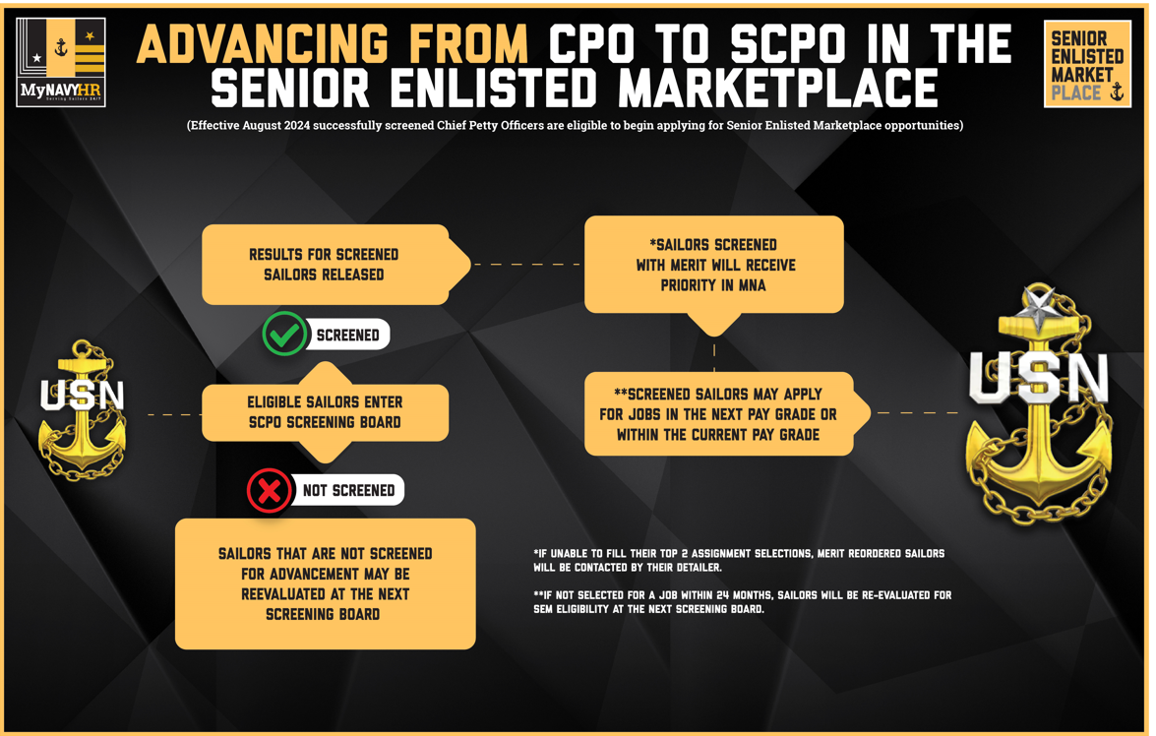
SENIOR ENLISTED MARKETPLACE (E7-E8)
Notes:
FACILITATOR GUIDE:
None

Slide 37
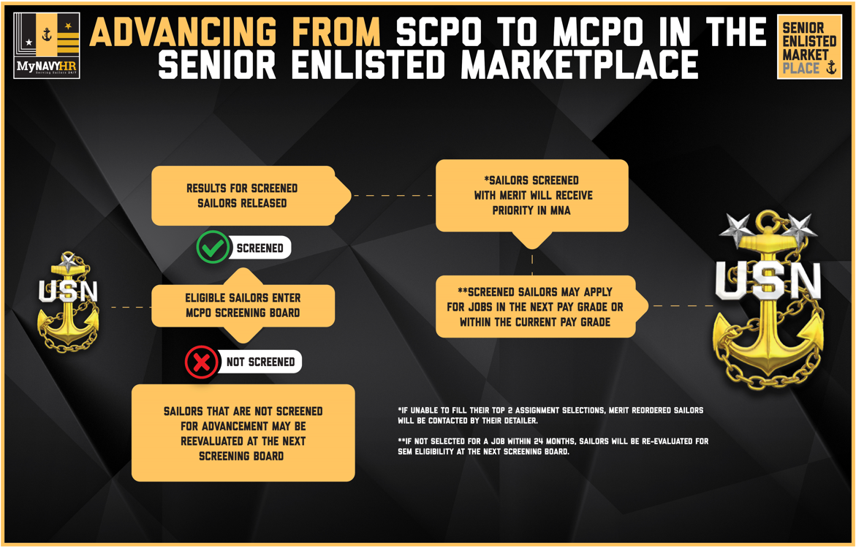
SENIOR ENLISTED MARKETPLACE (E8-E9)
Notes:
FACILITATOR GUIDE:
None

Slide 38
Knowledge Check
Which advancement program allows automatic advancement to E4 regardless of current paygrade?
What is the total possible points an E6 candidate can have for their final multiple score?
What block on a Sailors evaluation is used to compute PMA?
Which advancement candidates are affected by RSCA?
What is the maximum PNA points a Sailor can have overall?
How often are Sailors required to complete PMK-EE?
Notes:
ANSWERS:
Accelerated advancement
230
45
E6 and E7
9
Once per paygrade

Slide 39
Summary and Review
In this lesson we discussed:
The Enlisted advancement process and eligibility requirements
Final Multiple Score (FMS) and contributing factors
Process for calculating Performance Mark Average (PMA) and Reporting Senior’s Cumulative Average (RSCA)
Time-in-Rate requirements
Passed-Not-Advanced (PNA) points and how it is awarded
Advancement incentive programs

Slide 40

Enlisted Advancement

